Slide 1
Ethernet to Multi-CANFD Bridge Expander in Robotics

Slide 2
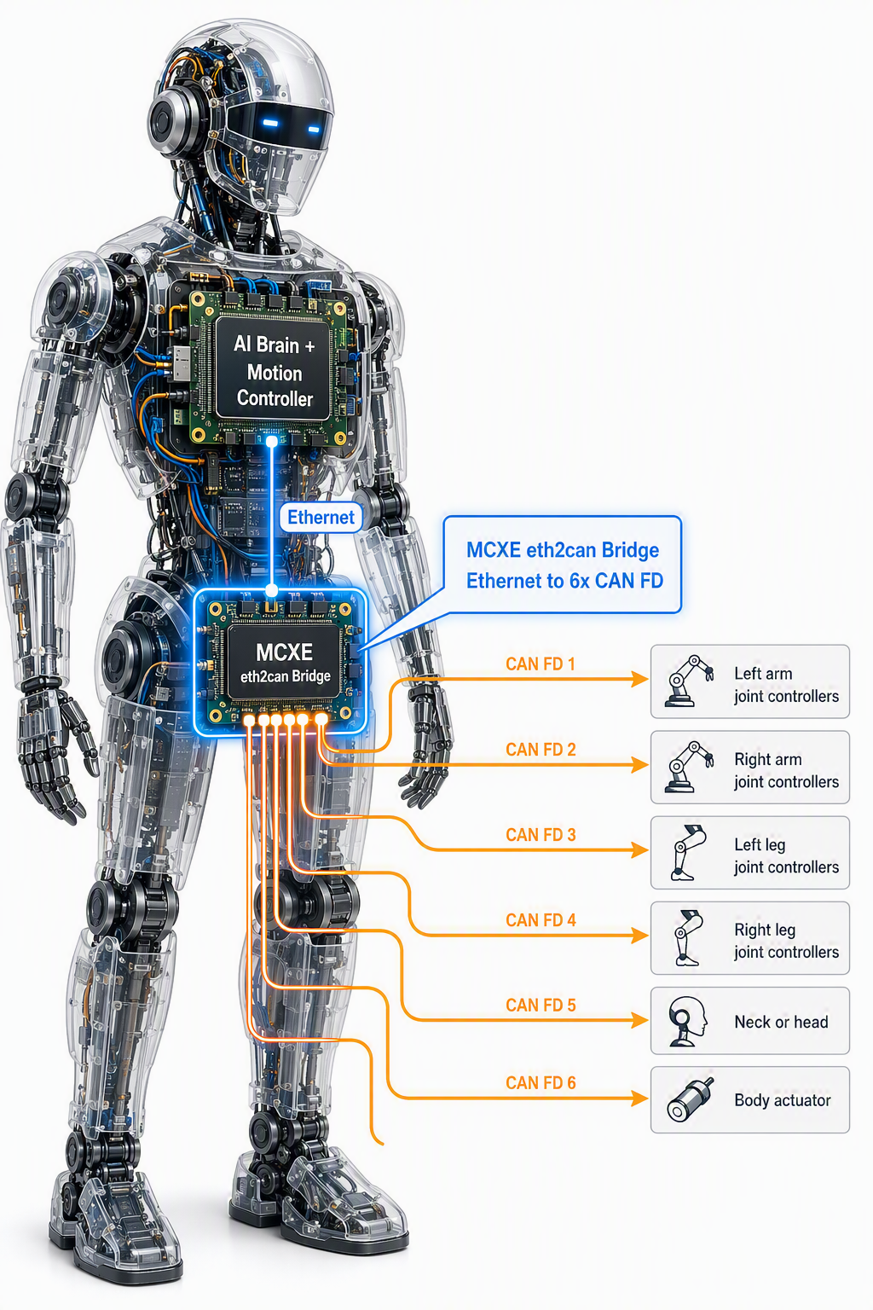
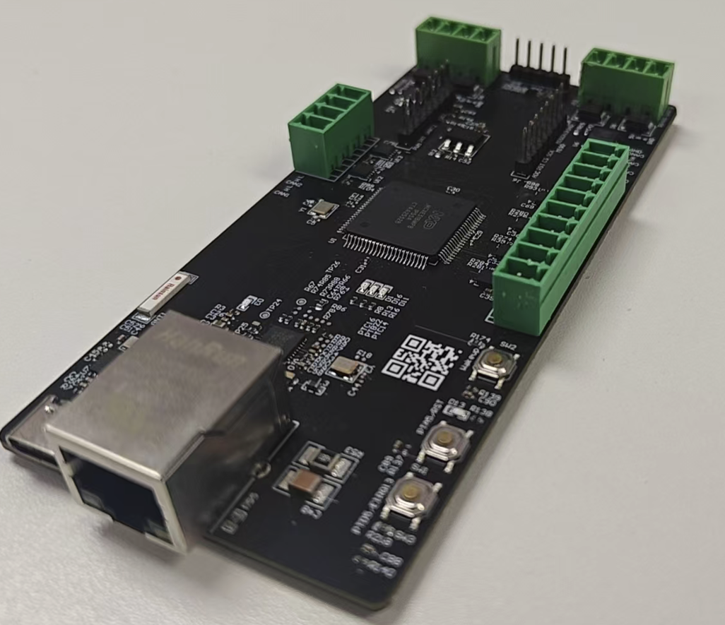
Ethernet to Multi-CANFD Bridge for Robotics
Key Features
6 × CANFD ports bridged to Ethernet on one cable
Deeply customized Linux SocketCAN using raw socket in Linux Kernel Mode, verified on NXP i.MX95 MPU
MCXE31B Cortex-M7F @160 MHz, bare-metal SW
Ethernet layer2 MAC to CANFD on MCXE31B, no LWIP Stack running
CANFD 1Mbps arb / 5-8 Mbps with 64Bytes Payload per frame
CAN data loop back(MPU->MCU->MPU) latency < 1ms with 99% statics, max. 1.5mS

Slide 3
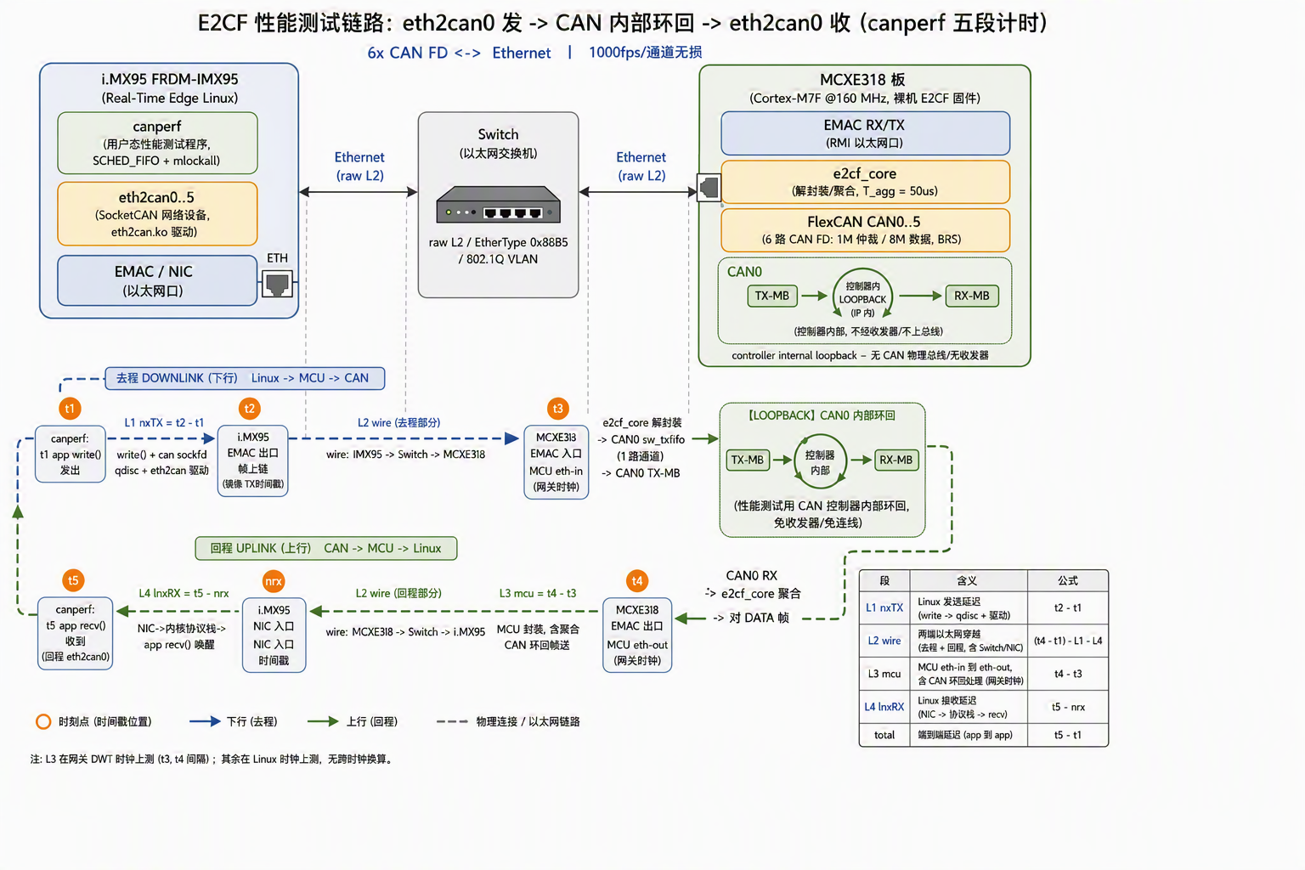

Slide 4
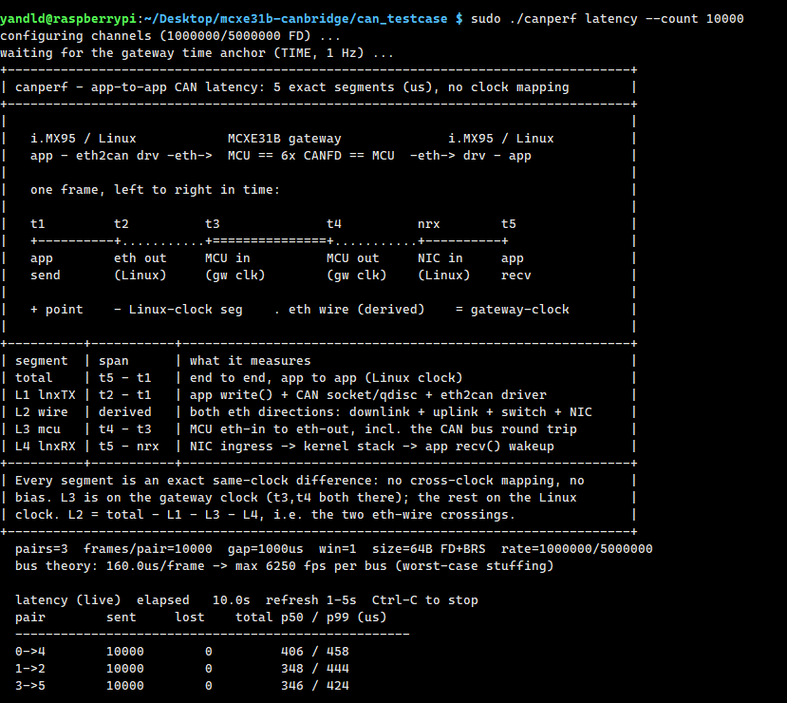
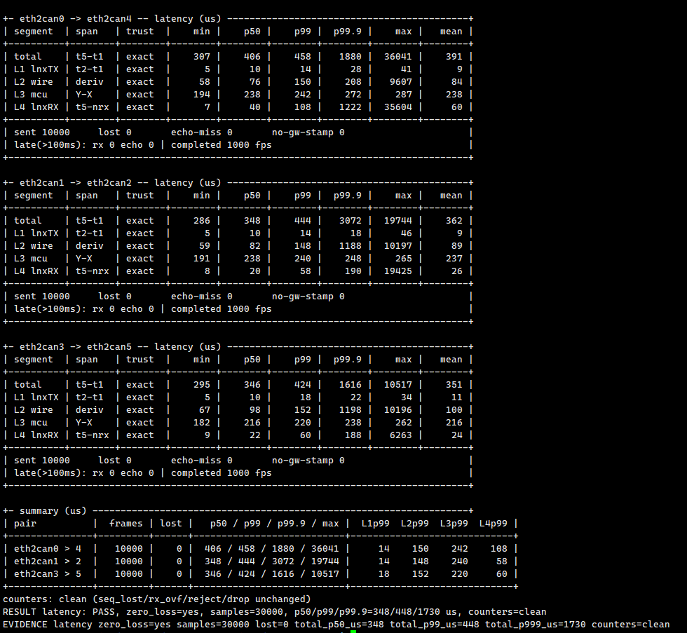
Latency test

Slide 5
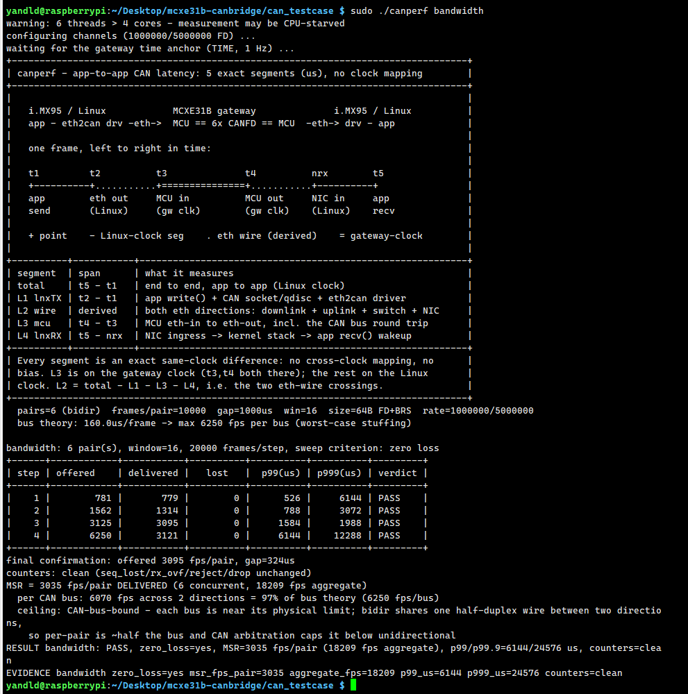
Stress test

